Slide 1
BAPTISM

Slide 2
Scheme of Redemption
Hear John 12:48
Believe John 8:24
Repent Luke 13:3
Confess Matt. 10:32-33
Baptized Mark 16:16
Faith
Faith

Slide 3
Baptism
What is Baptism?
Baptism in the Bible
Blessings of Baptism
Who should be baptized?

Slide 4
What is BAPTISM?

Slide 5
Exactly what is Baptism?
Act of Baptism- which is it?
The ‘MODE’ of baptism is very important to understand.
Generic term meaning sprinkling, pouring, or an immersion.
Originally meant ‘an immersion’ but for Jesus & Apostles meant only sprinkling or pouring.
One definite and specific sense: dipping or an immersion.

Slide 6
Baptism –
Root Words
What does the word “baptism” or “baptize” mean?
Greek word ‘baptisma’ (noun) is rendered ‘baptism’.
Similarly, ‘baptizo’ (verb) is translated ‘baptize”.

Slide 7
What is Baptizo?
The Greeks used baptizo to describe the dyeing of a garment, in which the whole material was plunged in and taken out from the element used.
Figuratively, baptizo pictures the introduction or placing of a person or thing into a new environment or into union with something else so as to alter its condition or its relationship to its previous environment or condition.

Slide 8
Baptizo: “To make a thing dipped or dyed. To immerse for a religious purpose” (A Critical Lexicon and Concordance to the English and Greek New Testament, E.W. Bullinger).
Baptizo: “Dip, immerse, mid. Dip oneself, wash (in non-Christian lit. also ‘plunge, sink, drench, overwhelm. . . .’)” (A Greek-English Lexicon of the New Testament, Arndt and Gingrich, p. 131).
Baptizo: “immersion, submersion” (A Greek-English Lexicon of the New Testament, Grimm-Thayer, p. 94).
Baptizo: “to dip, immerse, sink” (Manual Greek Lexicon of the New Testament, Abbott-Smith, p. 74).
Baptizo: “dip, plunge” (A Greek-English Lexicon, Liddell & Scott, p. 305).
Baptizo: “consisting of the process of immersion, submersion and emergence (from bapto, to dip)” (Expository Dictionary of New Testament Words, W. E. Vine).
Baptizo: “immerse, submerge. The peculiar N.T. and Christian use of the word to denote immersion, submersion for a religious purpose” (Biblico-Theological Lexicon of the New Testament Greek, Cremer).
Baptizo: “to dip, immerse; to cleanse or purify by washing” (The New Analytical Greek Lexicon, Perschbacher, p. 66).
Baptizo: “to dip, to immerse, to sink. . . . There is no evidence that Luke or Paul and the other writers of the New Testament put upon this verb meanings not recognized by the Greeks” (Greek and English Lexicon, Sophocles).
Baptizo: “Bapto is the basic verb. It means ‘to dip in’ or ‘to dip under.’ It is often used of dipping fabric in a dye. Baptizo is an intensive form of bapto. From early times it was used in the sense of immersing” (Expository Dictionary of Bible Words, Lawrence O. Richards, pp. 100-101).
Baptizo: “Baptizo, immerse” (Word Study Greek-English New Testament, Paul. R. McReynolds, p. 907).
Baptizo: “The meaning of bapto and baptizo. bapto, ‘to dip in or under,’ ‘to dye,’ ‘to immerse,’ ‘to sink,’ ‘to drown,’ ‘to bathe,’ wash.'” (Theological Dictionary of the New Testament, One Volume, ed. Geoffrey W. Bromiley, p. 92).
Baptizo: “Baptizo 77x pr. to dip, immerse; to cleanse or purify by washing; to administer the rite of baptism, to baptize” (Greek and English Interlinear New Testament, William D. Mounce and Robert H. Mounce, p. 1028).

Slide 9
Baptism Is Immersion in the Bible
We don’t need to know Greek to understand Biblical Baptism.
John 3:23 Why was John baptizing in that location?
Mark 1:9-10 What about Jesus and the water?
Acts 8:36-39 What do we learn about the Eunuch’s baptism?
Romans 6:4 What is baptism compared to?

Slide 10
The word “BAPTIZE” originates from a Greek word “BAPTIZO” meaning “immerse”. And the word “BAPTISM” comes from a Greek word “BAPTISMA” which means “to submerge in water”.
Therefore, baptism by sprinkling or by pouring is an oxymoron, something that is self-contradictory.
Baptism by sprinkling would mean “submerging someone in water by sprinkling water on them.”
Baptism, by its inherent definition, MUST be an act of immersion in water.

Slide 11
BAPTISM in the Bible

Slide 12
Baptism Types & Antitypes

Slide 13
What are Biblical Types & Antitypes?
A type is a symbol appointed by God to adumbrate something higher in the future, which is called the antitype.

Slide 14
What are Biblical Types & Antitypes?
TYPE
a symbol of something in the future
- as an Old Testament event serving as a prefiguration of a New Testament event.
ANTITYPE
something that is foreshadowed by a type or symbol
- as a New Testament event prefigured in the Old Testament.

Slide 15
Baptism Types & Antitypes
TYPE
Noah & Ark
1 Peter 3:20-21
Israelites crossing Red Sea
1 Corinthians 10:1-4
Naaman the Leper
2 Kings 5:11-14
ANTITYPE
Baptism
Saved by Water
Required Action
God saved them through their Obedience

Slide 16
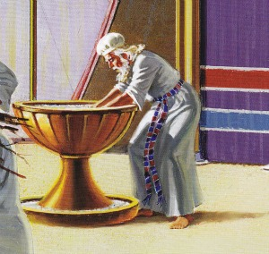
Baptism in the Bible – Old Testament
We do not find New Testament Baptism in the Old Testament.
However, the Jews were very familiar with the concept of ‘washing’ or ‘immersion’ for cleansing (either actually or symbolically).
Exodus 40:30-31
He set the laver between the tabernacle of meeting and the altar, and put water there for washing; and Moses, Aaron, and his sons would wash their hands and their feet with water from it.

Slide 17
Baptism in the Bible – Old Testament
We do not find New Testament Baptism in the Old Testament.
However, the Jews were very familiar with the concept of ‘washing’ or ‘immersion’ for cleansing (either actually or symbolically).
Leviticus 14:8-9 (Cleansing of Leper)
He who is to be cleansed shall wash his clothes, shave off all his hair, and wash himself in water, that he may be clean. After that he shall come into the camp, and shall stay outside his tent seven days. But on the seventh day he shall shave all the hair off his head and his beard and his eyebrows—all his hair he shall shave off. He shall wash his clothes and wash his body in water, and he shall be clean.

Slide 18
Baptism in the Bible – Old Testament
We do not find New Testament Baptism in the Old Testament.
However, the Jews were very familiar with the concept of ‘washing’ or ‘immersion’ for cleansing (either actually or symbolically).
Psalm 51:1-3
Have mercy upon me, O God,
According to Your lovingkindness;
According to the multitude of Your tender mercies,
Blot out my transgressions.
Wash me thoroughly from my iniquity,
And cleanse me from my sin.

Slide 19
Baptism in the Bible – Baptism of John
Matthew 3:1-6, 11
Does Baptism seem new to them?
Roots in Jewish ceremonial washing
What did John preach / people do ?
Repent! (vs 2) = turn, think differently
Baptized with water (vs 6, 11)
People Confessed their sins (vs 6)
Prepared them for the coming of the Messiah
A better baptism would follow (vs. 11)
Acts 19:1-5

Slide 20
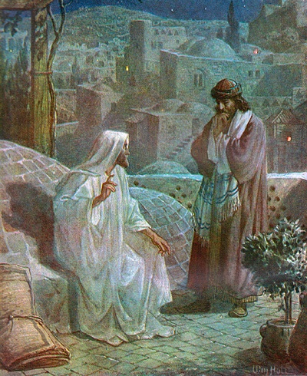
Jesus Introduces Baptism
John 3:1-7
What’s going on here?
Nicodemus is confounded. He didn’t understand what being born anew was about. He thought that to have eternal life he must be ‘re-born’ physically.
Jesus speaks of a new birth from baptism, which gives eternal life and membership into the family of God.

Slide 21
Jesus Instructed His Apostles to Baptize
The Great Commission
Matthew 28:16-20
Then the eleven disciples went away into Galilee, to the mountain which Jesus had appointed for them. When they saw Him, they worshiped Him; but some doubted.
And Jesus came and spoke to them, saying, “All authority has been given to Me in heaven and on earth. Go therefore and make disciples of all the nations, baptizing them in the name of the Father and of the Son and of the Holy Spirit, teaching them to observe all things that I have commanded you; and lo, I am with you always, even to the end of the age.” Amen.

Slide 22
Jesus Instructed His Apostles to Baptize
The Great Commission
Mark 16:15-16
And He said to them, "Go into all the world and preach the gospel to every creature. He who believes and is baptized will be saved; but he who does not believe will be condemned."

Slide 23
Apostles Taught Baptism
Peter on Pentecost Acts 2:38-41
Peter at the House of Cornelius Acts 10:44-48
Philip to the Samaritans Acts 8:5-12
Philip to the Eunuch Acts 8:36-38
Paul to Lydia Acts 16:13-15
Paul to Philippian Jailor Acts 16:30-34
Paul recounting His Conversion Acts 22:10-16

Slide 24
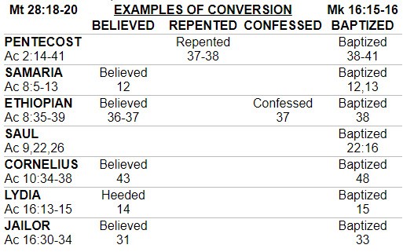
Every “Conversion” in Acts includes Baptism

Slide 25
There is only One Baptism
Ephesians 4:1-6
I, therefore, a prisoner for the Lord, urge you to walk in a manner worthy of the calling to which you have been called, with all humility and gentleness, with patience, bearing with one another in love, eager to maintain the unity of the Spirit in the bond of peace. There is one body and one Spirit—just as you were called to the one hope that belongs to your call— one Lord, one faith, one baptism, one God and Father of all, who is over all and through all and in all.

Slide 26
Purpose & Blessings of Baptism

Slide 27
Purpose & Blessings of Baptism
Forgiveness of Sins
The Gift of the Holy Spirit
United with Christ
Newness of Life
Salvation
Entrance into the Church

Slide 28
Forgiveness of Sins
Forgiveness of sins is made possible through the blood of Jesus Ephesians 1:7
Such forgiveness is promised to those who repent and are baptized Acts 2:36-38; 22:12-16
Baptism results in forgiveness of sins through the blood of Christ

Slide 29
The Gift of the Holy Spirit
The Holy Spirit is Promised to Believers who are Baptized
By Jesus - John 7:37-39
By Peter – Acts 2:38
We are unified in the Spirit through Baptism
1 Corinthians 12:12-13

Slide 30
United with Christ
Union with Christ is Necessary for Survival
John 15:4-6
We are united with Christ in Baptism
Galatians 3:27
Romans 6:1-4

Slide 31
Newness
of Life
Dying to Sin and Rising with Christ
Romans 6:5-11
Buried with Christ, Made Alive with Him
Colossians 2:11-13
God makes us alive by forgiving our trespasses

Slide 33
Salvation
Saving companion with Belief
Mark 16:16
Baptism Saves Us
1 Peter 3:21

Slide 34
Entrance into the Church
Entrance into the Kingdom of God (realm of saved)
John 3:5
Those SAVED were added to the community of believers (the church) by the LORD.
Acts 2:37-45

Slide 35
Is Baptism Necessary for Salvation?
Salvation takes God’s part, which is grace (Ephesians 2:8), mercy (Titus 3:5), Christ Jesus (Matthew 1:21); His life (Romans 5:10); His blood (Romans 5:9); and the Gospel of Christ (1 Corinthians 15:1-4).
Salvation also takes man’s part, which is faith (Romans 5:1); works (James 2:24); calling on the name of the Lord (Romans 10:13); hope (Romans 8:24); our effort (Acts 2:40); and being baptized (1 Peter 3:21).
The Bible does not teach that man is saved by anything alone. God, through His Word, the Bible, says it takes all of these things to save us from our sins. To deny such is to deny the Word of God!

Slide 36
Extra Slides for Discussion if Needed

Slide 37
Baptism: A Commemoration
Event Commemoration
Creation Sabbath
Sparing of 1st Born Passover
Giving of 1st Law (Sinai) Feast of Pentecost
Sojourning of Israelites Feast of Tabernacles
Death of Jesus Lord’s Supper
Death, Burial, Resurrection Baptism

Slide 38
Question:
If we are told that to be saved, we must be baptized by being dunked in water, how or what allowances do you make for the sick, bedridden, old, or too young, who cannot go into the water and dunk their head?
Answer:
The argument is flawed because it seeks to find some exception to a rule to declare that the rule is therefore optional or unnecessary. Even if an exception were found, it would not change the rule itself. The point is that you are able to be baptized as God commanded; therefore, claiming that an imagined other person might not be able to be baptized does not excuse you from the command.

Slide 39
Where then did sprinkling or pouring come from? The first recorded case in all of early church history was that of Novatian in 251 AD, who lay sick on his bed and water was poured on him.
Who made this first exception, man or God?
Man did without the authorization of God. God has not approved of it. Sprinkling is just as vain as if it had never been done. This man-made exception over the centuries became the man-made accepted practice until at the Council of Ravenna in 1311 AD, man legalized sprinkling for baptism, but without God's authority. Since sprinkling is without God's authority, if you were sprinkled or poured, then you have not been scripturally baptized, and you still have every sin that you have ever committed and are still lost.

Slide 40
Some Religious Institutions:
“Baptism is super important. It is commanded of every Christian. If you have not been biblically baptized, you are walking in sin. Baptism is not optional. If someone just refused to be baptized, I would call their salvation into question; not because baptism saves you, but rather they are claiming that they love Christ while refusing to obey him.”
The Bible does not teach that baptism alone saves! However, it does teach that man is saved by baptism.
Many religious people think, “He that believeth is saved and should be baptized.”

Slide 41
People who don’t think Baptism is necessary for salvation say that "to obey God" is the main purpose of baptism. Then why is that purpose never stated?
Is it not singular that the New Testament failed to mention the main purpose in connection with the command, but on the other hand emphasized the non-essential purpose, or the purpose not necessary to be believed? "Remission of sins", "into Christ", "shall be saved," "newness of life," and all other expressions are just one design stated in different ways. Baptism has only one design - salvation.

